Slide 1
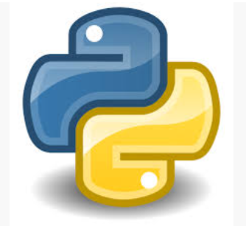

MYL Technologies
Python

Slide 2
Programming Language
What is a programming language ?
A programming language is a formal language used to communicate instructions to a computer. It provides a set of rules, syntax, and symbols that enable developers to write programs or software that tell the computer what actions to perform. These instructions could involve anything from simple calculations to complex operations like building websites, controlling hardware, managing data, or running entire systems.
Syntax
Semantics
Keywords and Commands
Data Types
Control Structures

Slide 3
Types of programming Languages
Low-Level Languages:
These languages are closer to machine code and hardware.
Examples: Assembly language, Machine code.
Pros: High performance and control over hardware.
Cons: Harder to learn and write due to their complexity and detailed syntax.
High-Level Languages:
These are closer to human languages and abstract away hardware details, making them easier to use.
Examples: Python, Java, C++, JavaScript.
Pros: Easier to learn, more readable, and portable across different platforms.
Cons: Less control over hardware, sometimes slower than low-level languages.

Slide 4
Types of programming Languages
Low-Level Languages:
These languages are closer to machine code and hardware.
Examples: Assembly language, Machine code.
Pros: High performance and control over hardware.
Cons: Harder to learn and write due to their complexity and detailed syntax.
High-Level Languages:
These are closer to human languages and abstract away hardware details, making them easier to use.
Examples: Python, Java, C++, JavaScript.
Pros: Easier to learn, more readable, and portable across different platforms.
Cons: Less control over hardware, sometimes slower than low-level languages.
Compiled vs. Interpreted Languages:
Compiled Languages (e.g., C, C++): The source code is translated into machine code by a compiler before execution, resulting in faster runtime.
Interpreted Languages (e.g., Python, JavaScript): The code is executed line by line by an interpreter at runtime, which makes development easier but can be slower in performance.

Slide 5
Examples of Popular Programming Languages:
Python: Known for its readability and simplicity. Widely used in web development, data science, automation, and artificial intelligence.
Java: A versatile, object-oriented language used for building enterprise applications, Android apps, and large systems.
JavaScript: Mainly used for web development to create interactive websites and web applications.
C++: A powerful language often used for system software, game development, and applications where performance is crucial.
SQL: A specialized language used for managing and querying databases.
Why Programming Languages Matter:
Automation: Programming languages allow repetitive tasks to be automated, saving time and reducing the possibility of human error.
Problem-Solving: They enable complex problems to be broken down into smaller, manageable tasks, allowing developers to create solutions that a computer can execute.
Innovation: Almost every digital product, from websites to smartphone apps and AI systems, relies on programming languages to bring ideas to life.
In essence, programming languages are the tools through which we instruct computers to perform tasks and solve problems, serving as the bridge between human logic and machine execution.

Slide 6
Examples of Popular Programming Languages:
Python: Known for its readability and simplicity. Widely used in web development, data science, automation, and artificial intelligence.
Java: A versatile, object-oriented language used for building enterprise applications, Android apps, and large systems.
JavaScript: Mainly used for web development to create interactive websites and web applications.
C++: A powerful language often used for system software, game development, and applications where performance is crucial.
SQL: A specialized language used for managing and querying databases.
Why Programming Languages Matter:
Automation: Programming languages allow repetitive tasks to be automated, saving time and reducing the possibility of human error.
Problem-Solving: They enable complex problems to be broken down into smaller, manageable tasks, allowing developers to create solutions that a computer can execute.
Innovation: Almost every digital product, from websites to smartphone apps and AI systems, relies on programming languages to bring ideas to life.
In essence, programming languages are the tools through which we instruct computers to perform tasks and solve problems, serving as the bridge between human logic and machine execution.

Slide 7
Our First Program - Print
Print(“Hello world!”)
Print(“Hello World! Hello World! Hello World! )
Print(“Hello world! \nHello world \nHello world”)
Print(“Hello” + “ “ + “Angela”)
Input(“what is your name”)
Print(“Hello” + input(“what is your name”))

Slide 8
Variables
What is a variable?
variables are used to store and manage data in memory. A variable is essentially a symbolic name or reference that points to an assigned value. You create a variable by assigning it a value using the equals sign (=). Variables in Python are dynamically typed, meaning that you don’t need to specify the type of data a variable will hold—Python automatically interprets it based on the assigned value.
Examples:
name = "Alice" # This is a string variable
age = 30 # This is an integer variable
height = 5.7 # This is a float variable
Key Points:
No Type Declaration: Unlike some other languages, you don’t declare the type of variable beforehand. The type is determined by the value assigned.
Dynamic Typing: You can change the type of a variable at any point by reassigning it a new value.
Naming Conventions: Variable names are case-sensitive and typically use lowercase letters and underscores (e.g., my_variable). They should start with a letter or underscore but cannot begin with a number
Types of variables:
Integers (int): Whole numbers, e.g., 10
Floating-Point Numbers (float): Decimal numbers, e.g., 3.14
Strings (str): Text enclosed in quotes, e.g., "Hello"
Booleans (bool): Represent True or False

Slide 9
Challenge
BAND NAME Generator
1)Get the name of the person’s favourite pet.
2)Get the name of the person’s favourite city?
3) Combine the pet’s name and city name to give back the suggested band name.
4) Please note that the after you get the pet name and city name as input, they should display in a new line.

Slide 10
Primitive Data types
In Python, the concept of "primitive" data types refers to the basic, built-in types that are not composed of other types. They represent the simplest forms of data and form the building blocks for more complex data structures. Here are the primitive data types in Python
Integer (int)
Used to store whole numbers, positive or negative, without decimals.
Float (float)
Represents numbers with decimal points (floating-point numbers)
Boolean (bool)
Represents one of two values: True or False.
Used for logical operations and conditional statement
String (str)
Used to store text data, represented as a sequence of Unicode characters.

Slide 11
Coding challenge
BMI Calculator:
Print the BMI of a person. Get the persons weight and height, calculate the BMI and print it to the person
Bill Calculator:
Get the total bill, tip that they would like to pay, how many persons should the bill be divided amongst. Using these info, calculate the bill amount that each person has to pay. Please note that the tip can be in rupees or a percentage of the total bill amount. However would you like to keep it, its fine !

Slide 12
Conditional operator if/else
The if and else statements in Python are used for decision-making. They allow you to run different pieces of code based on whether a condition is true or false.
Syntax:
if condition:
# code to execute if the condition is true
else:
# code to execute if the condition is false
temperature = 30
if temperature > 25:
print("It's hot outside!")
else:
print("It's not too hot.")
temperature = 15
if temperature > 25:
print("It's hot outside!")
elif temperature > 15:
print("It's warm outside.")
else:
print("It's cold outside!")

Slide 13
Modulo Operator
The modulo operator in Python is represented by the % symbol. It is used to find the remainder when one number is divided by another.
result = a % b
The modulo operator returns the remainder when the left operand is divided by the right operand.
print(10 % 3) # Output: 1, because 10 divided by 3 is 3 with a remainder of 1
print(20 % 4) # Output: 0, because 20 divided by 4 is exactly 5 with no remainder
print(15 % 6) # Output: 3, because 15 divided by 6 is 2 with a remainder of 3
num = 7
if num % 2 == 0:
print("Even")
else:
print("Odd")
# Output: "Odd"

Slide 14
Comparison Operators
== -- equality
!= -- Not equal to
> -- greater than
>= -- greater than or equal to
< -- less than
< = -- less than or equal to
Chaining comparisons
= -- assignment
a = 5
a == 5

Slide 15
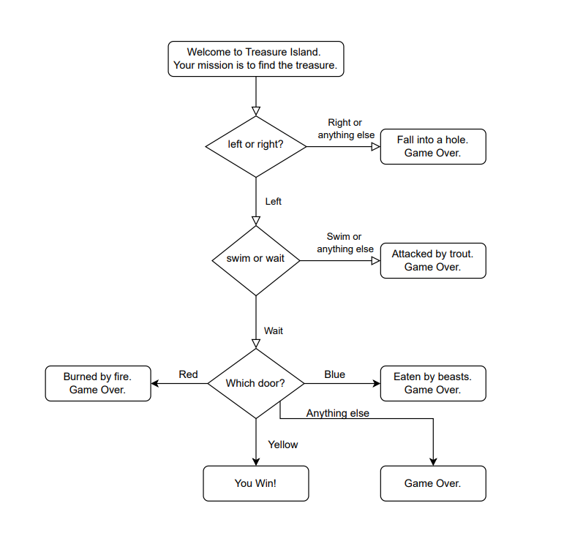
Treasure Island Project

Slide 16
Randomisation
Random Pseudo number
Mersenne Twister
Python:
Random module
Random.randint
Random.random
Random.uniform
Heads or Tails using Random Generator

Slide 17
Lists
Data, data, data, data …
What is a list?
A list in Python is a collection of items (also called elements) that are ordered and mutable. Lists are versatile and widely used in Python due to their ability to store multiple data types, including other lists.
Key Features of Lists:
Ordered: Elements in a list have a specific order and can be accessed using their index.
Mutable: You can change the content of a list (add, remove, or modify elements).
Heterogeneous: A single list can contain elements of different types (integers, strings, floats, other lists, etc.).
Dynamic: Lists can grow or shrink as elements are added or removed.
Creating a list
Common Operations
Accessing Elements
Slicing
Modifying Lists
Adding Elements
Removing Elements
Iterating Through a List

Slide 18
Exercise
Five friends visit a restaurant to dine. To decide who will pay the bill, they usually write each person’s name on a chit of paper and randomly pick one. Now, simulate this process by selecting the person using Python's random number generator.
Simulate Rock, Paper, Scissors game.

Slide 19
loops
For loop
Syntax:
for variable in sequence:
# Code block to execute
variable: A placeholder that takes on the value of each element in the sequence, one at a time.
sequence: The iterable object you’re looping through (e.g., list, range, string, etc.).
The code block runs once for every element in the sequence.
fruits = ["apple", "banana", "cherry"]
for fruit in fruits:
print(fruit)
for i in range(5): # Iterates from 0 to 4
print(i)
matrix = [[1, 2, 3], [4, 5, 6], [7, 8, 9]]
for row in matrix:
for value in row:
print(value, end=" ")
print() # Move to the next line

Slide 20
Mini Project
Project: Number Guessing Game
Objective:
The user will try to guess a randomly chosen number within a given range. The program will provide hints like "too high" or "too low" after each guess. The player has a limited number of attempts.

Slide 21
While loop and Mini Project
i = 0
while i < 5:
print(i)
i += 1
Infinite loops
Project: Word Scramble Game
Objective:
The program presents a scrambled version of a word.
The user has to guess the original word.
The game provides unlimited attempts to guess correctly, but you can quit anytime.

Slide 22
Exercise
Welcome to the pypassword generator
How many letters would you like in your password?
(Get input)
How many symbols would you like?
(Get input)
How many numbers would you like?
4
Your password is “randompassword”

Slide 23
Functions
What Are Functions in Python?
In Python, functions are blocks of reusable code that are used to perform a specific task. You can think of a function as a way to organize your code into smaller, manageable parts, making it easier to understand, maintain, and reuse.
Key Characteristics of Functions:
Reusability: Once a function is defined, it can be called multiple times without needing to rewrite the same code.
Abstraction: Functions allow you to hide complex implementation details behind a simple interface.
Input and Output: Functions can accept inputs (called parameters or arguments) and return outputs (called return values).
Defining a Function
A function is defined using the def keyword, followed by the function name and parentheses () (which may contain parameters). The function body is indented and contains the code that will be executed when the function is called.
def function_name(parameters):
# Function body
# Code to execute
return value # Optional: return a result (if needed)

Slide 24
Functions
def greet():
print("Hello, welcome to the Python world!")
# Call the function
greet()
def greet(name):
print(f"Hello, {name}!")
# Call the function with an argument
greet("Alice")
greet("Bob")
def add(a, b):
return a + b
# Call the function and use the result
result = add(3, 4)
print(result)

Slide 25
Functions
Types of functions:
Built-in Functions: Python comes with a set of built-in functions like print(), len(), max(), min(), etc., that you can use directly without defining them yourself.
print(len("Hello")) # Built-in function to get the length of a string
User-Defined Functions: Functions that you define in your program to perform specific tasks.
def square(x):
return x * x
Lambda Functions (Anonymous Functions): These are small, one-line functions defined using the lambda keyword.
square = lambda x: x * x
print(square(5)) # Output: 25

Slide 26
Functions
Function Parameters and Arguments
Parameters are the variables listed inside the parentheses in the function definition.
Arguments are the actual values passed to the function when calling it.
You can define functions with:
Positional Arguments: Arguments passed in a specific order.
Keyword Arguments: Arguments passed by explicitly specifying the parameter names.
Default Parameters: Parameters with default values if no argument is provided.
Variable-Length Arguments: Functions that accept any number of arguments.
def greet(name, greeting="Hello"):
print(f"{greeting}, {name}!")
# Call with only name
greet("Alice")
# Call with both name and greeting
greet("Bob", "Good morning")

Slide 27
Functions
Variable-Length Arguments
If you want to pass a variable number of arguments, you can use *args for non-keyword arguments and **kwargs for keyword arguments.
def sum_numbers(*args):
return sum(args)
# Call with different numbers of arguments
print(sum_numbers(1, 2, 3)) # Output: 6
print(sum_numbers(4, 5)) # Output: 9

Slide 28
Tuple
A tuple is an immutable (unchangeable) sequence of items. It is often used when you want to store a collection of items that should not be modified.
Key Characteristics of Tuples
Defined using parentheses () or no brackets at all.
Items in a tuple are ordered.
Can contain elements of different data types.
Immutable: Once created, you cannot change, add, or remove items.
Examples of Tuples:#
Creating a tuple
my_tuple = (1, 2, 3, 4)
print(my_tuple) # Output: (1, 2, 3, 4)
# Accessing tuple elements
print(my_tuple[0]) # Output: 1
print(my_tuple[-1]) # Output: 4
# Tuple with mixed data types
mixed_tuple = ("apple", 10, 3.5, True)
print(mixed_tuple) # Output: ('apple', 10, 3.5, True)
# Nesting tuples
nested_tuple = (1, (2, 3), (4, 5))
print(nested_tuple) # Output: (1, (2, 3), (4, 5))

Slide 29
Dictionary
A dictionary is a collection of key-value pairs. It is used to store data values where each key is associated with a specific value.
Key Characteristics of Dictionaries
Defined using curly braces {}.
Keys must be unique and immutable (e.g., strings, numbers, or tuples).
Values can be any data type and can repeat.
Keys allow you to access values efficiently.
# Creating a dictionary
my_dict = {"name": "Alice", "age": 25, "city": "New York"}
print(my_dict) # Output: {'name': 'Alice', 'age': 25, 'city': 'New York'}
# Accessing values
print(my_dict["name"]) # Output: Alice
print(my_dict.get("age")) # Output: 25
# Adding or updating key-value pairs
my_dict["age"] = 26 # Update age
my_dict["profession"] = "Engineer" # Add a new key-value pair
print(my_dict)
# Output: {'name': 'Alice', 'age': 26, 'city': 'New York', 'profession': 'Engineer'}
# Removing a key-value pair
del my_dict["city"]
print(my_dict)
# Output: {'name': 'Alice', 'age': 26, 'profession': 'Engineer'}
# Iterating over a dictionary
for key, value in my_dict.items():
print(f"{key}: {value}")
# Output:
# name: Alice
# age: 26
# profession: Engineer

Slide 30
ARGS AND KWARGS IN PYTHON FUNCTIONS
*args: Allows you to pass a variable number of positional arguments to a function. The arguments are collected into a tuple.
**kwargs: Allows you to pass a variable number of keyword arguments to a function. The arguments are collected into a dictionary.
Both are used when you're unsure how many arguments a function might receive or want to handle flexible arguments dynamically.
def greet(*names):
for name in names:
print(f"Hello, {name}!")
# Using the function
greet("Alice", "Bob", "Charlie")
# Output:
# Hello, Alice!
# Hello, Bob!
# Hello, Charlie!
def display_info(**info):
for key, value in info.items():
print(f"{key.capitalize()}: {value}")
# Using the function
display_info(name="Alice", age=25, city="New York")
# Output:
# Name: Alice
# Age: 25
# City: New York
def introduce_people(greeting, *names, **details):
print(greeting)
print("Names:", ", ".join(names))
print("Details:")
for key, value in details.items():
print(f"{key.capitalize()}: {value}")
# Using the function
introduce_people(
"Welcome everyone!",
"Alice", "Bob", "Charlie",
event="Python Workshop", location="Room 101"
)
# Output:
# Welcome everyone!
# Names: Alice, Bob, Charlie
# Details:
# Event: Python Workshop
# Location: Room 101

Slide 31
Programming is like going to the gym.
Hard Work and Perseverance beats raw talent !!!

